Slide 1

Multi-sensor rail track detection in automatic train operations
Master’s thesis in Data Science
Student: Attila Kovacs
1st Advisor: Lukas Rohatsch (FH Technikum)
2nd Advisor: Daniele Capriotti (M2C Expert Control GmbH)
Alignment: 29.02.2024

Slide 2
Outline
Time plan
Writing thesis
Testing labeling approach
Isolating tracks

Slide 3
Timeline
Sep 23
Oct 23
Nov 23
Dec 23
Jan 24
Feb 24
Mar 24
Apr 24
May 24
Jun 24
DSP Kick-off
Exploratory Data Analysis
Literature Review
Base Model Selected
Establishing Baseline (CV2)
Model Finetuning
Result Analysis and Documentation of Approach
First Version Ready
Final Version Ready
Master‘s Exam

Slide 4
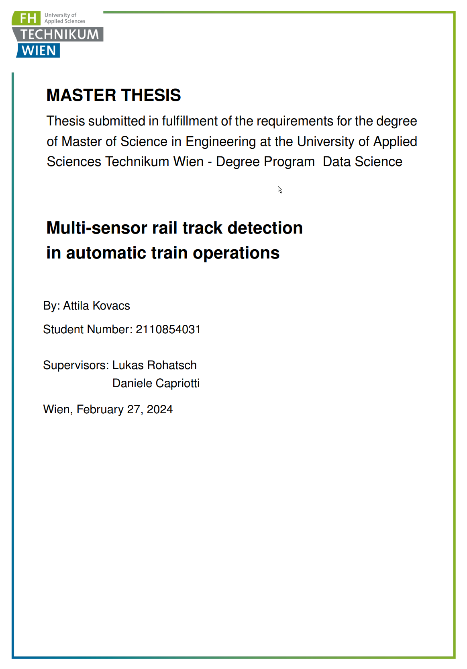
Writing thesis
~ 5000 words

Slide 5
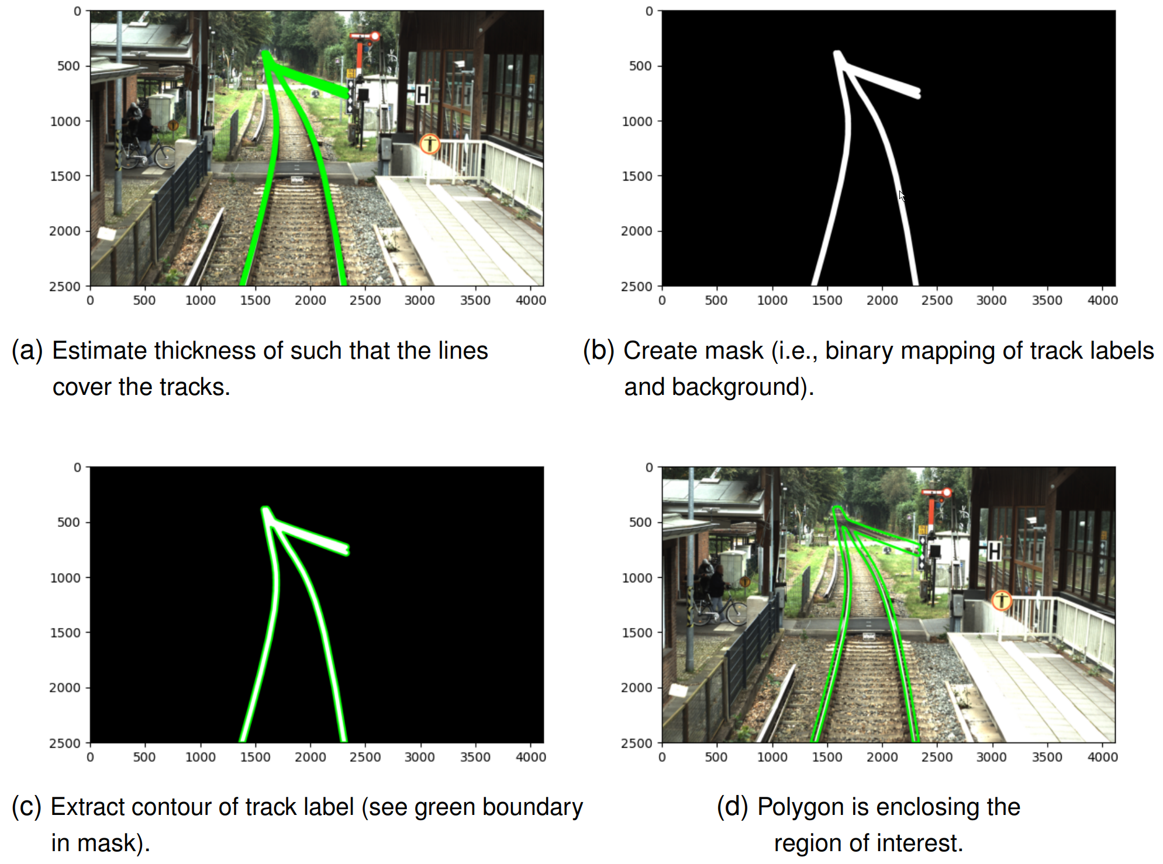
Labeling approach

Slide 6
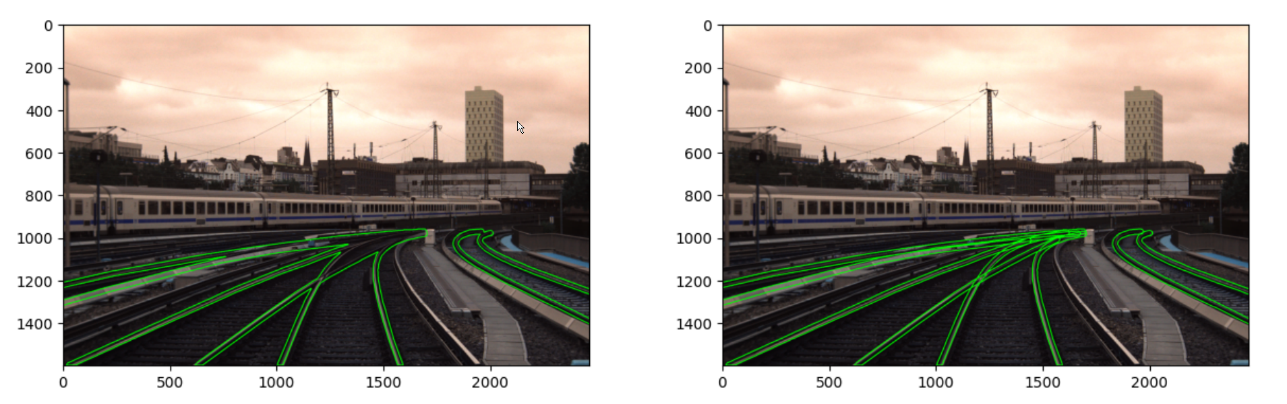
Labeling approach

Slide 7
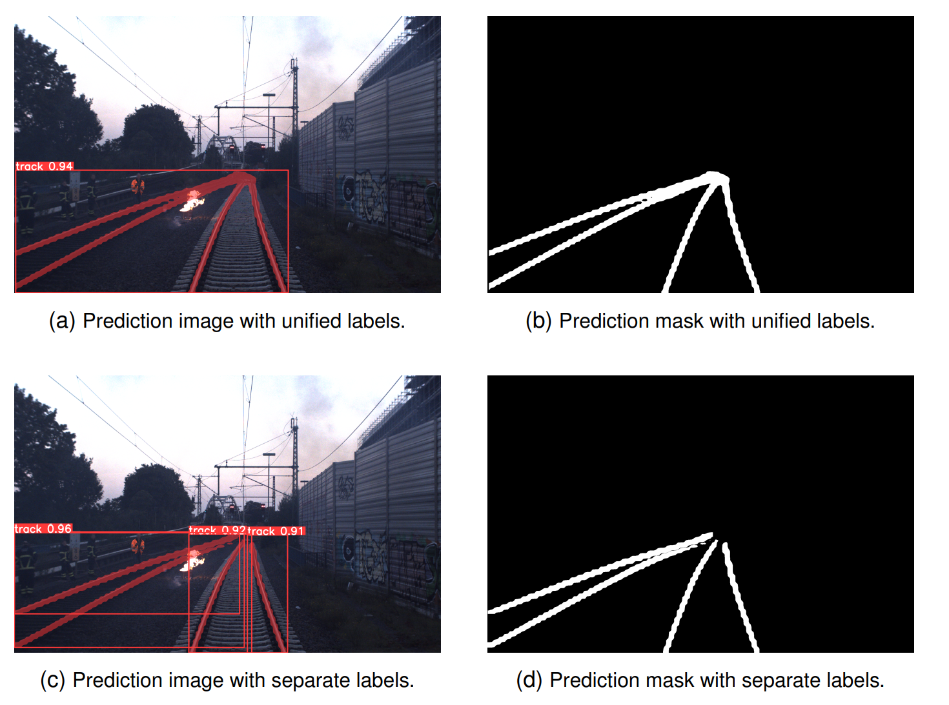
Results of different labeling approaches

Slide 8
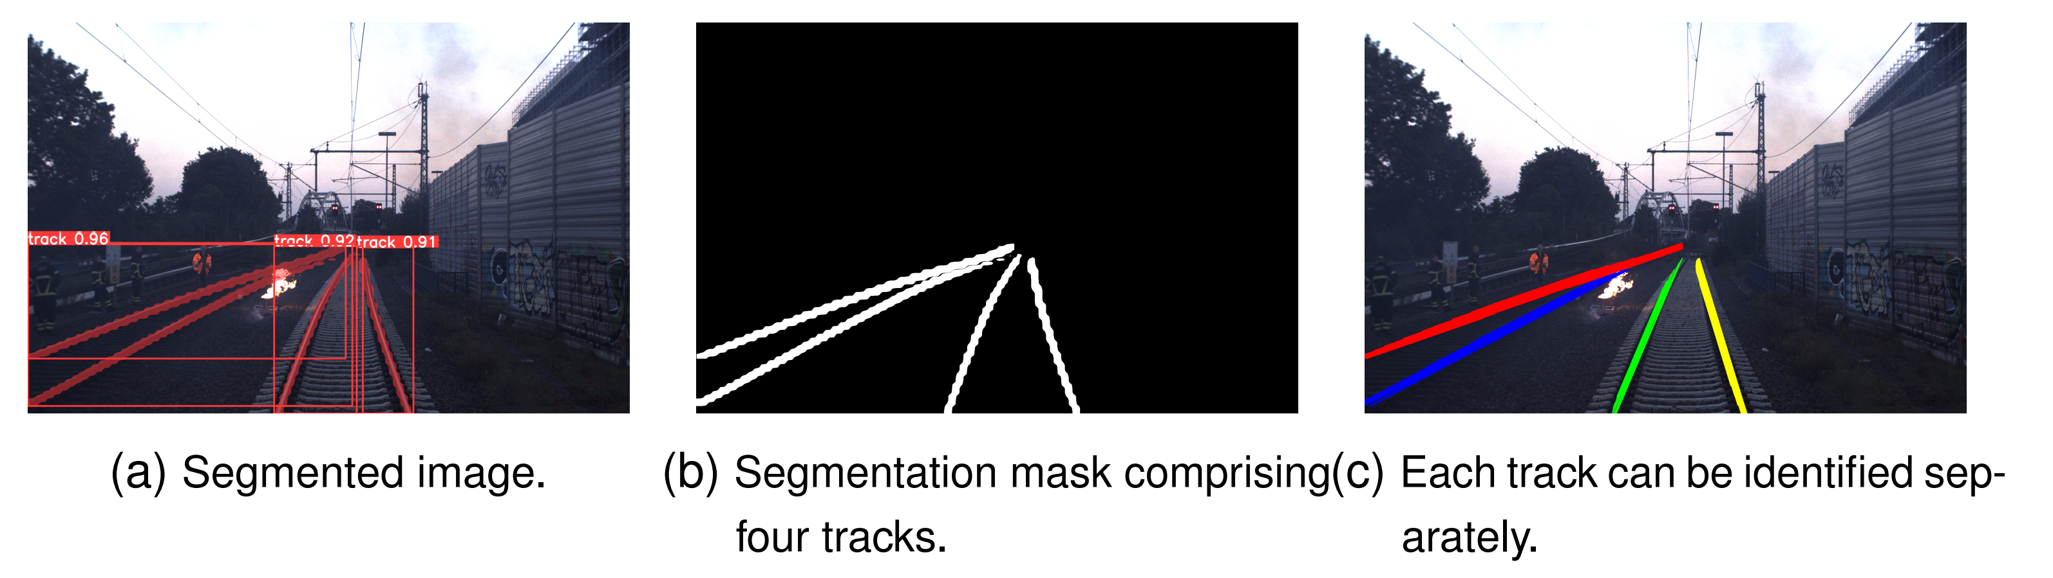
Isolating tracks

Slide 9
Thank you!

